Slide 1
Implementation Tutorial: Bayesian Deep Learning
Hae Beom Lee
MLAI, KAIST
24. Sep. 2019.

Slide 2
Overview
This tutorial is scheduled as follows:
1. Variational Autoendoer – 1.5 hour.
2. MC-dropout – 1.5 hour.
3. Concrete-dropout – (if time allows)

Slide 3
Environments
Prerequisites
Linux or macOS
Python >= 2.7
Tensorflow >= 1.3
Github Repositories
VAE: https://github.com/haebeom-lee/vae
MC-dropout: https://github.com/haebeom-lee/mc-dropout
Concrete-dropout: https://github.com/haebeom-lee/concrete-dropout

Slide 4
Part I: Variational Autoencoder (VAE)

Slide 5
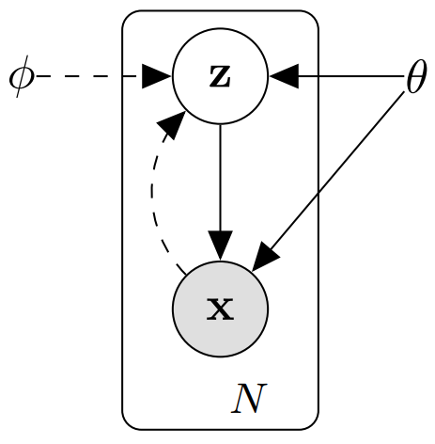
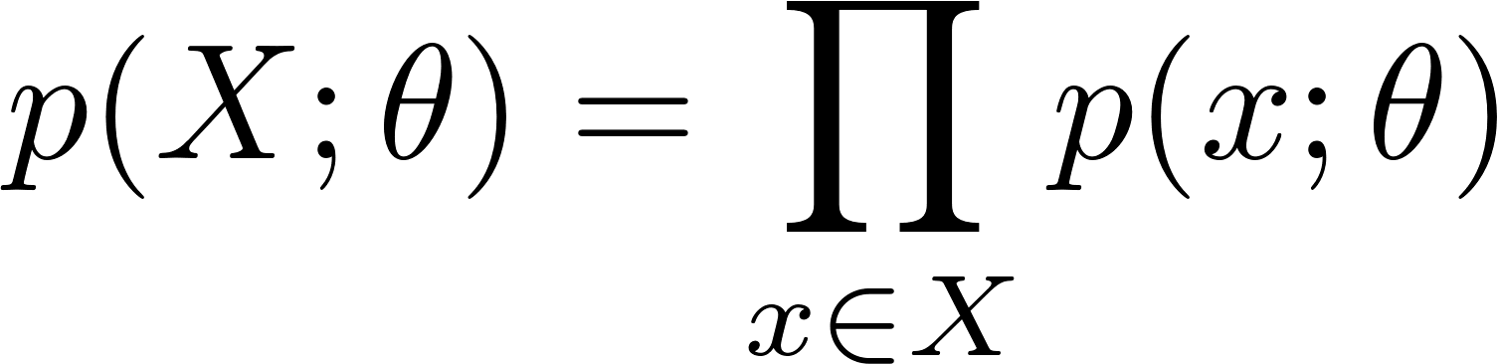
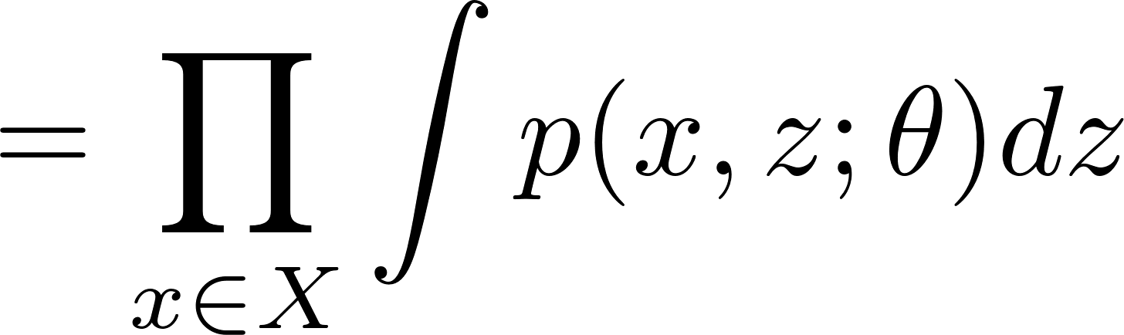
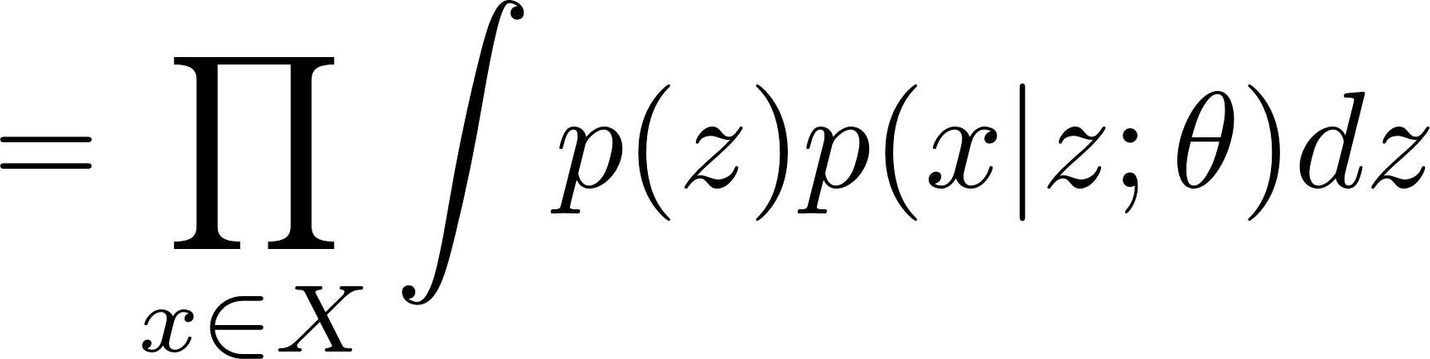
Generative process
For unsupervised learning.
Graphical model and generative process is as follows.

Slide 6
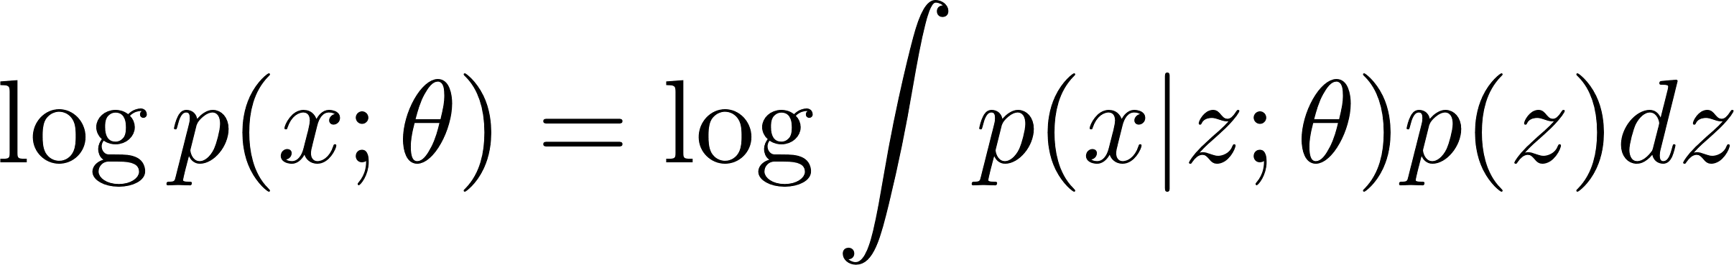
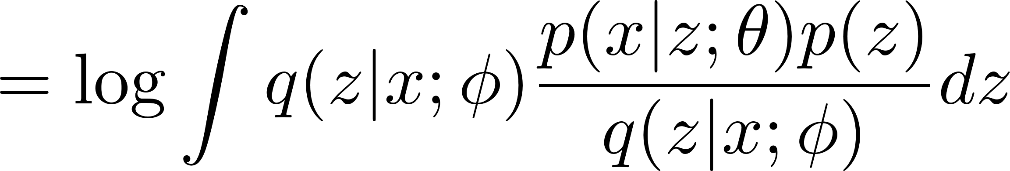
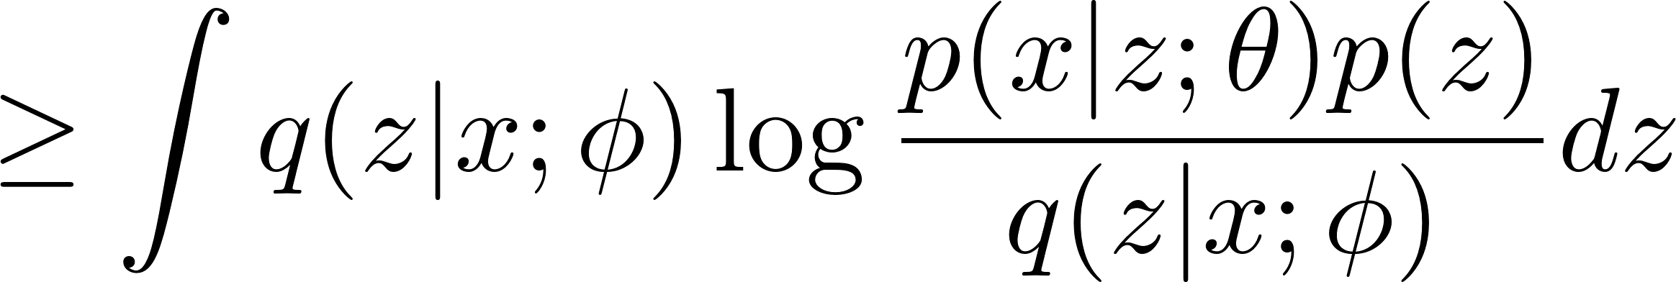
Evidence lower bound
Get the log evidence lower bound → maximization objective.
For each datapoint x, we have

Slide 7
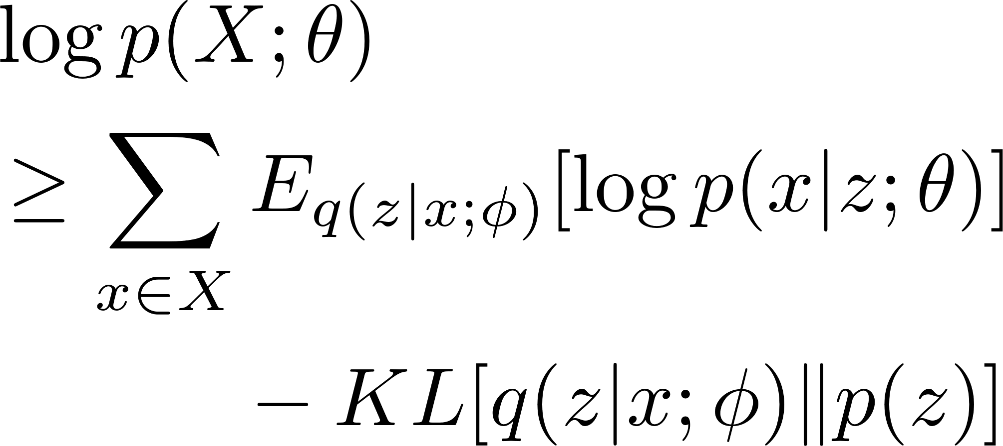
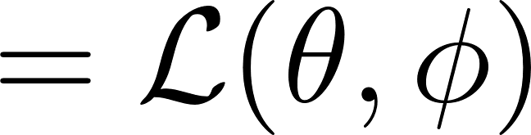
Evidence lower bound
Get the log evidence lower bound → maximization objective.
autoencoder
KL-divergence
(regularizer)

Slide 8
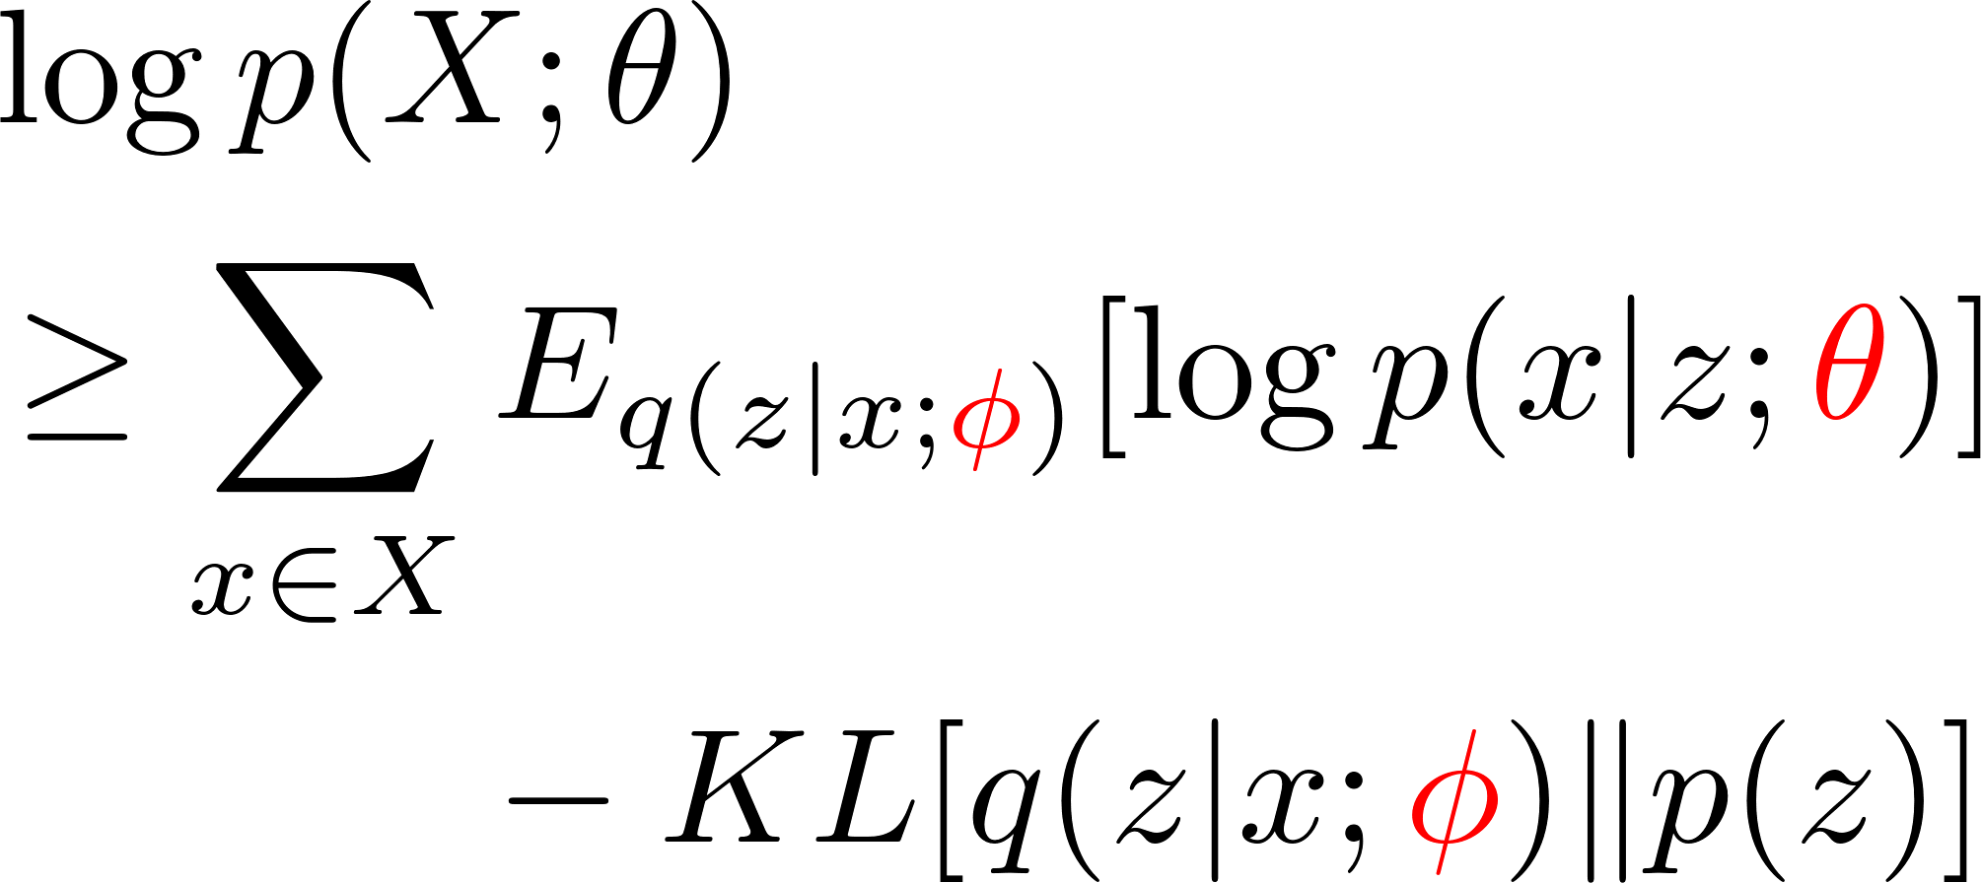
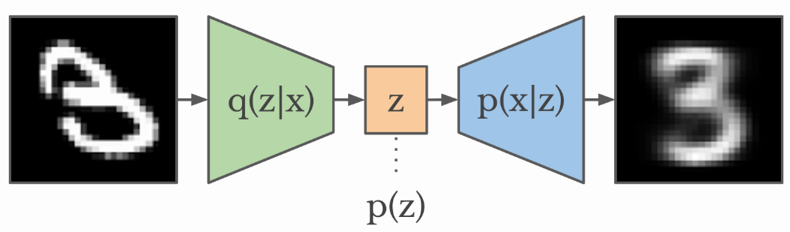
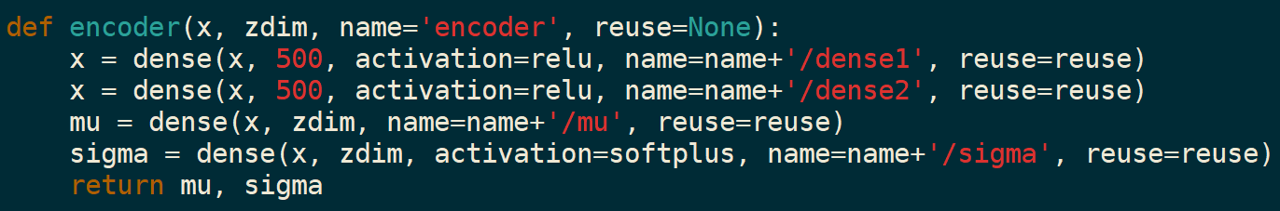
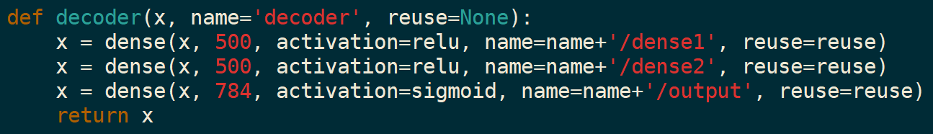


Structure of VAE
$$φ$$
$$θ$$
model.py

Slide 9
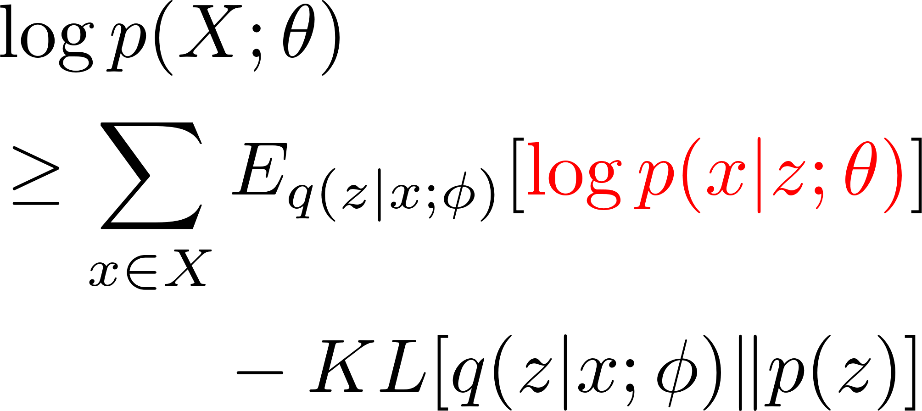
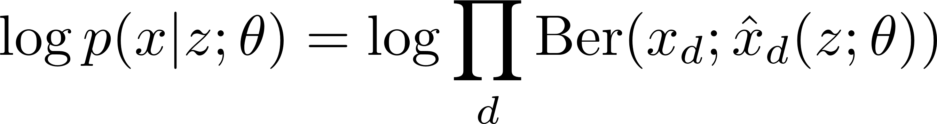
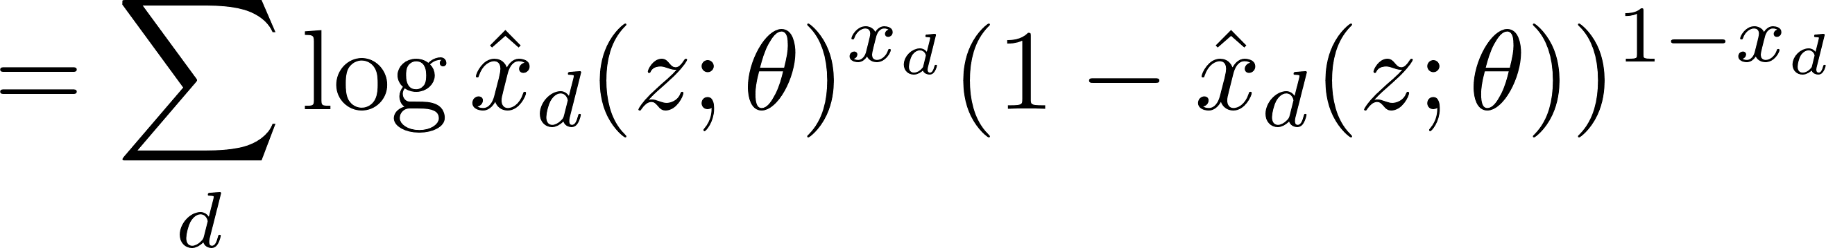
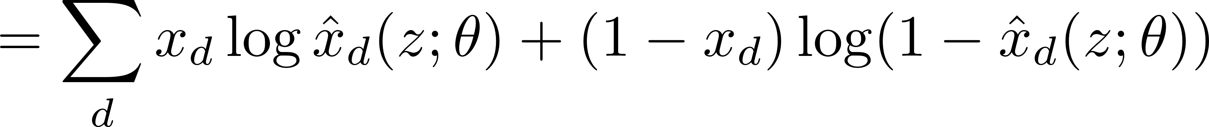
Modeling the log likelihood
Bernoulli likelihood for MNIST data (binary)
model.py line 21
(But actually this is wrong...)

Slide 10
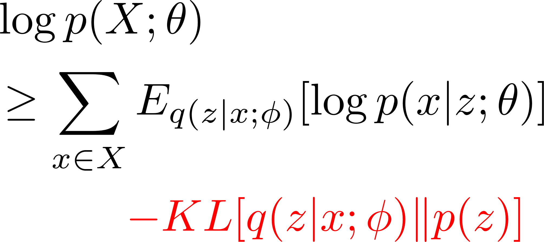
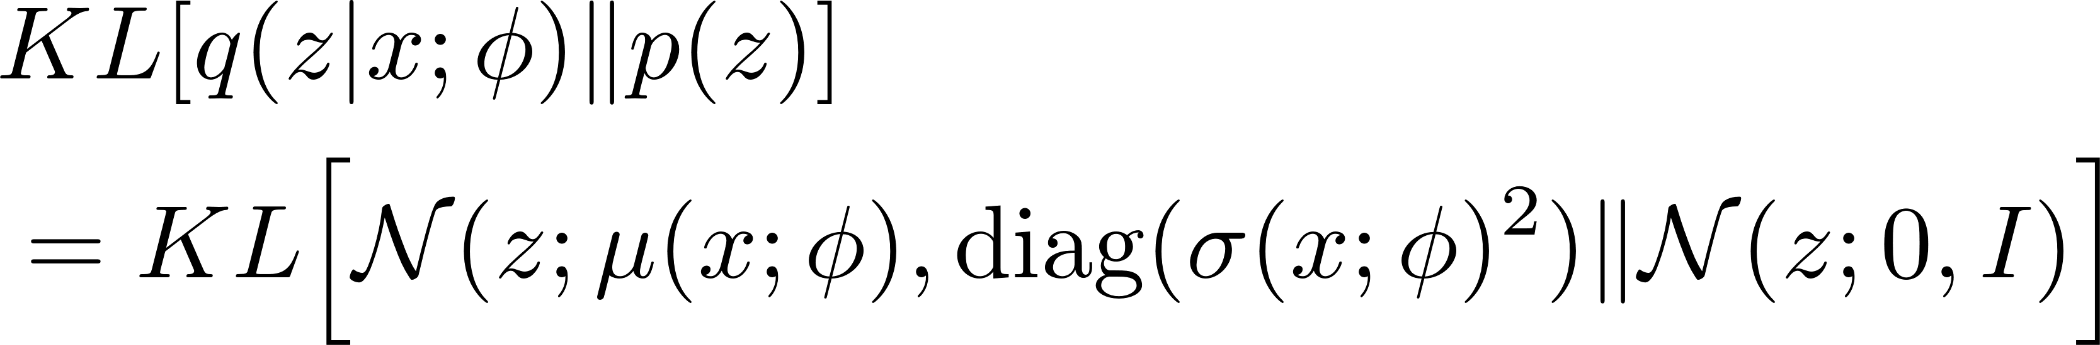
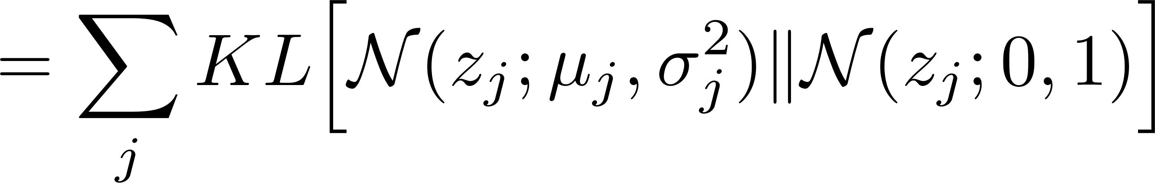
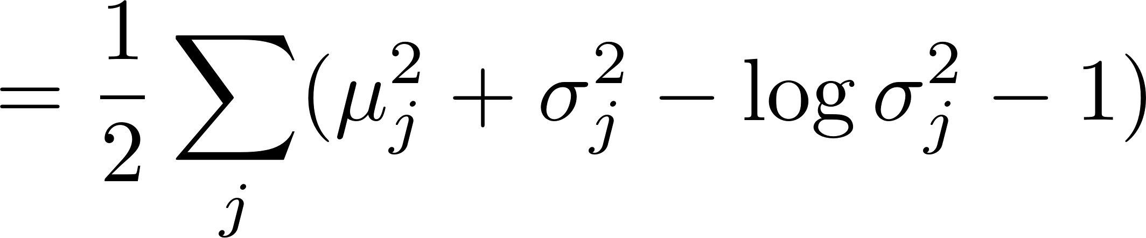
KL divergence
between gaussian prior and posterior has a closed form.
model.py line 22

Slide 11
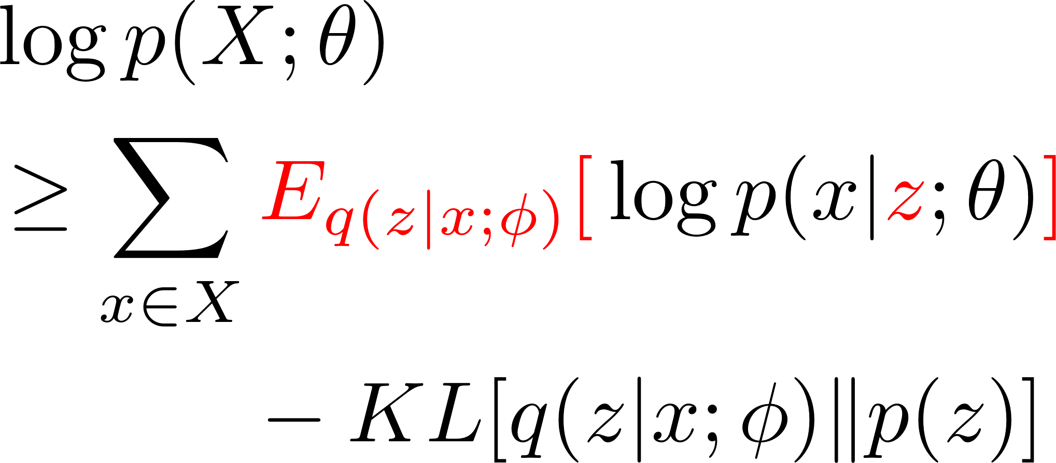
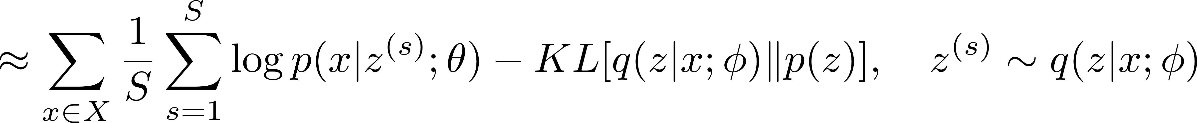
Monte-Carlo approximation
Approximate the expectation with MC sampling
By setting S=1, we have

Slide 12
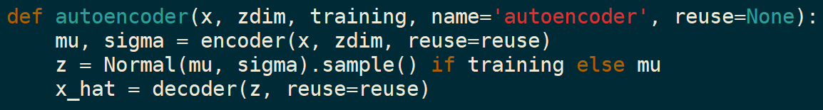
Reparameterization trick
Reparameterize the likelihood function
With MC approximation, we have
model.py line 16

Slide 13
Minibatch SGD
mini-batch size = M
model.py line 23

Slide 14
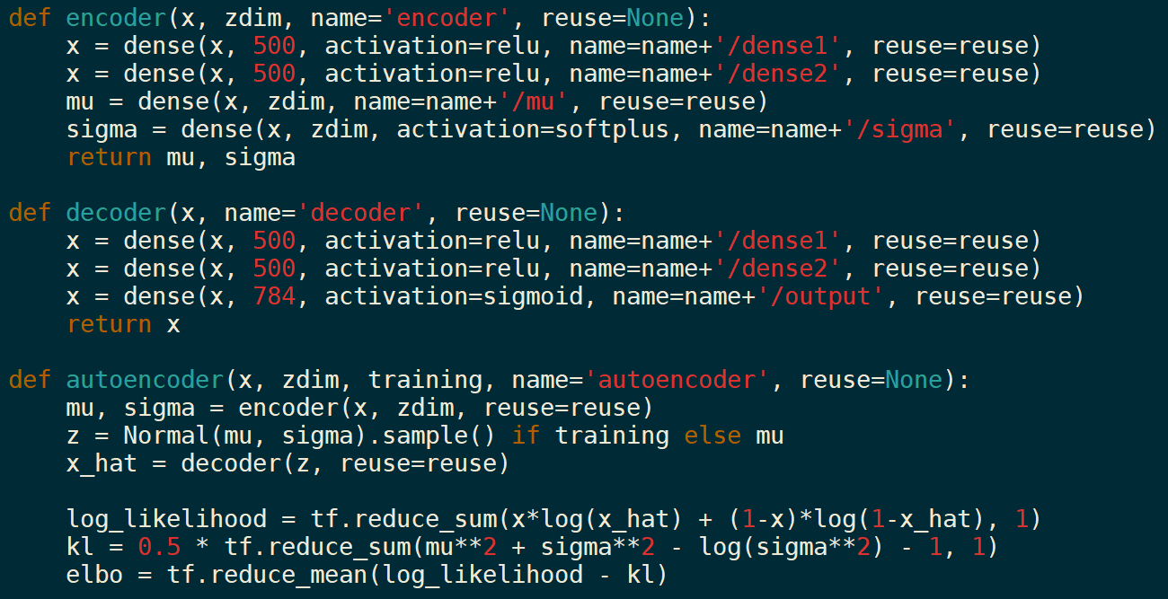

Slide 15
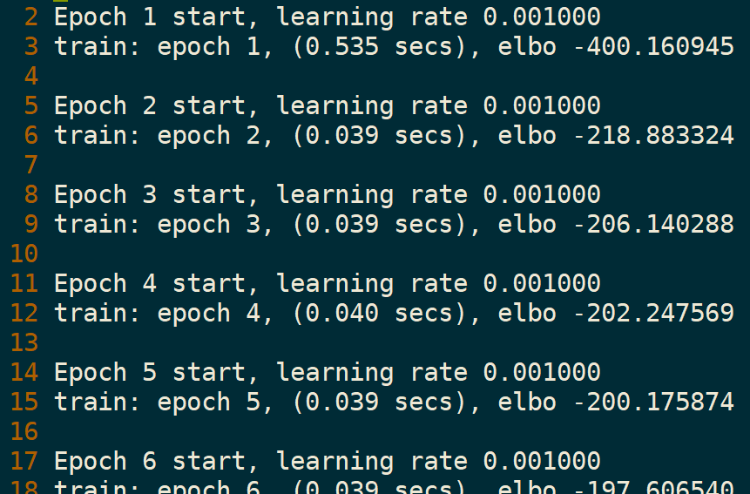
Training

Slide 16
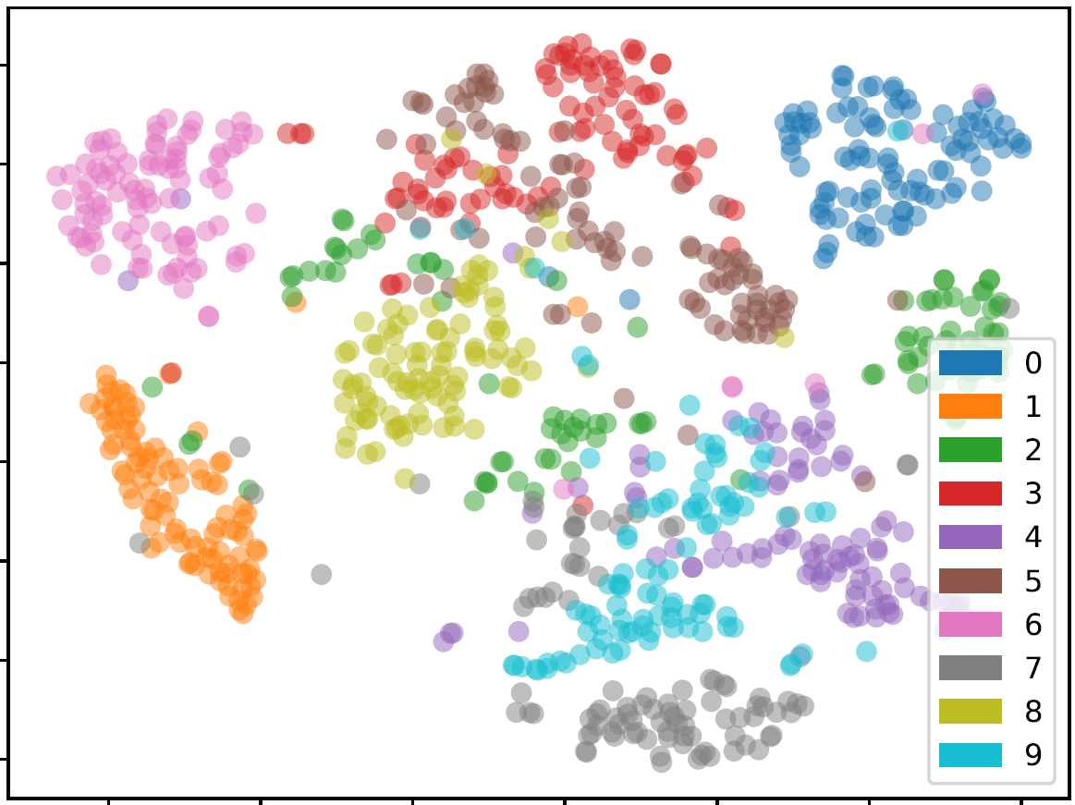
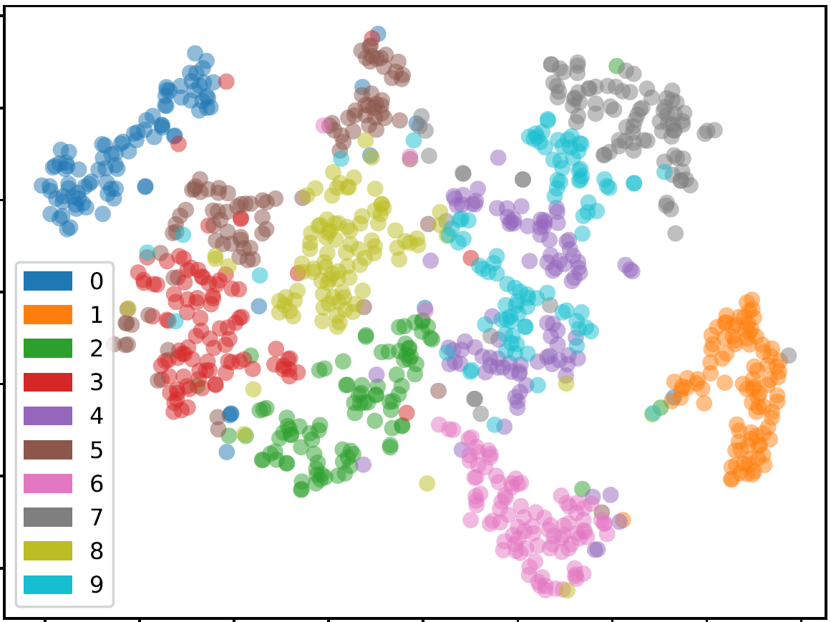
Learned q(z|x)
visualize with T-SNE
train
test

Slide 17
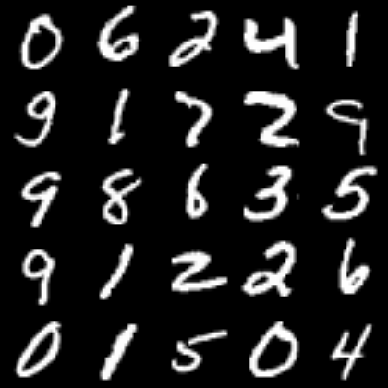
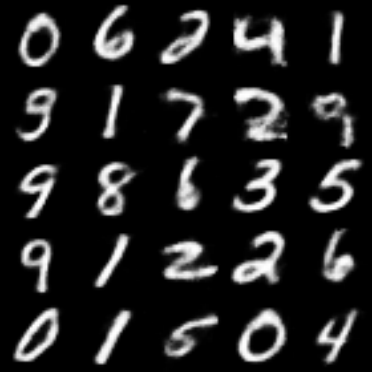
Reconstruction
with train instances
original
reconstructed

Slide 18
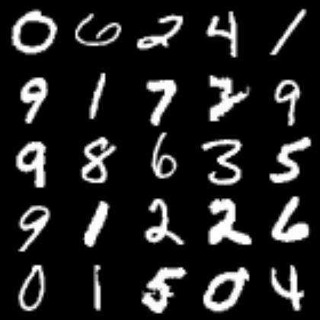
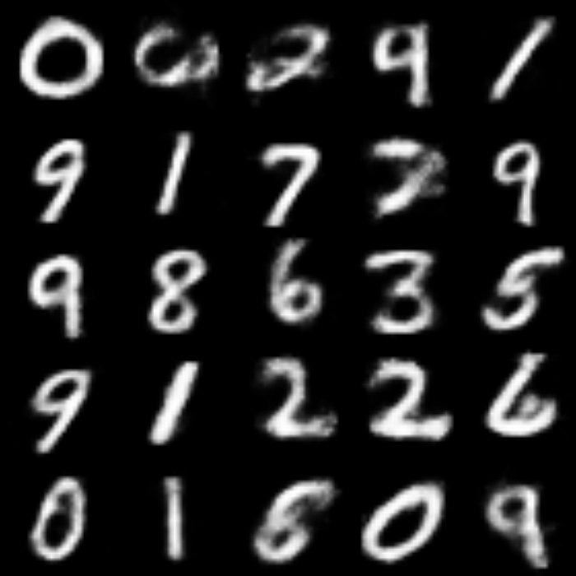
Reconstruction
with test instances
original
reconstructed

Slide 19
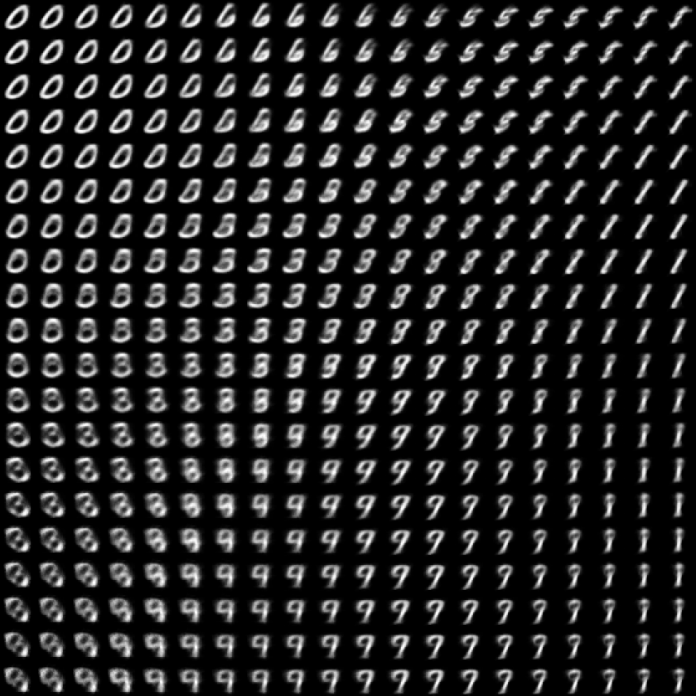
Learned manifold

Slide 20
Part II: MC-dropout

Slide 21
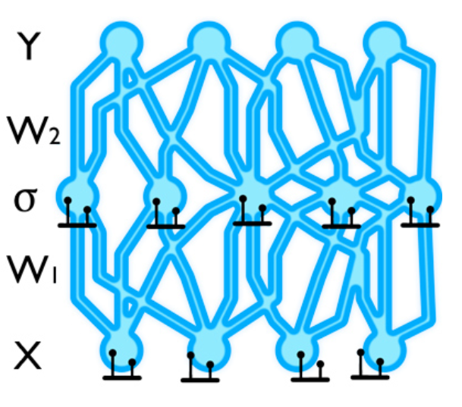
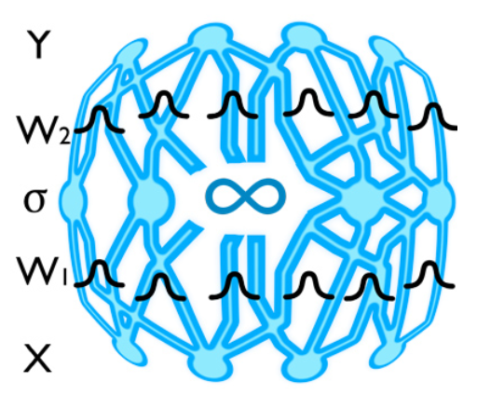
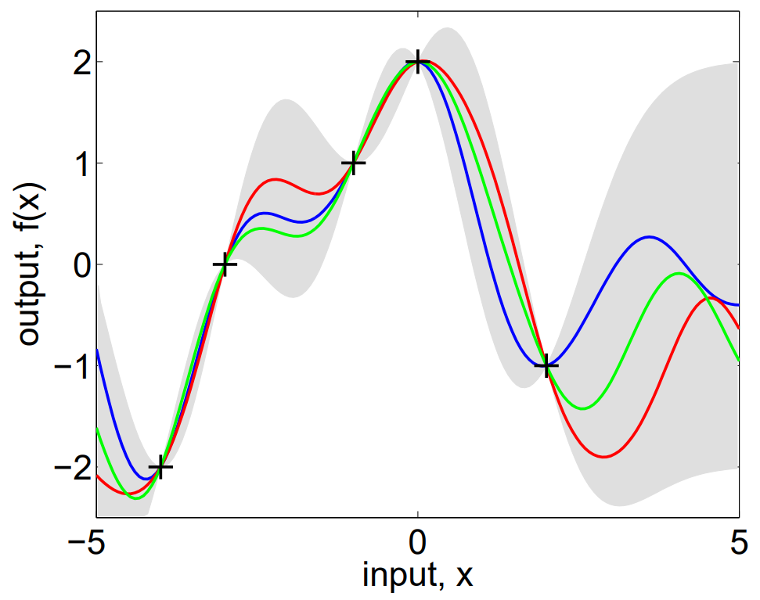

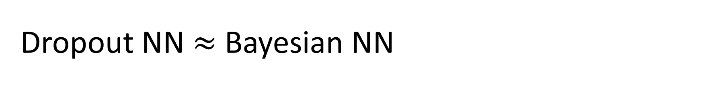


Dropout NN $≈$ Bayesian NN
For supervised learning.
Dropout NN can be interpreted as a variational approximation of Bayesian NN.
$$≈$$
$$≈$$
Dropout NN
Bayesian Neural Network
(many layers)
(deep) Gaussian Process
Contribution of [Gal15]
Contribution of [Gal15]

Slide 22
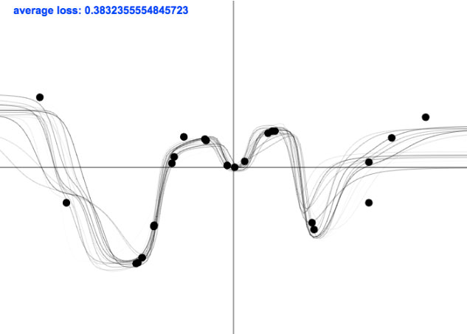
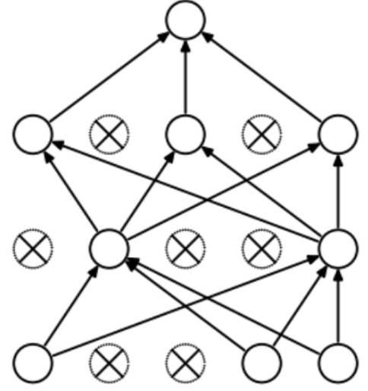
Dropout function draw
Each solid black line is a function drawn from dropout sampling.

Slide 23
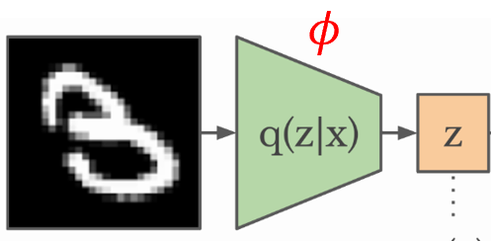

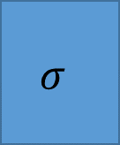
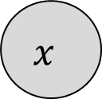
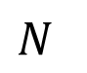
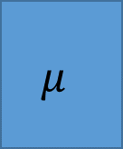
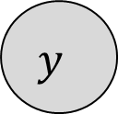

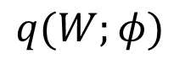
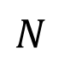
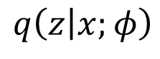
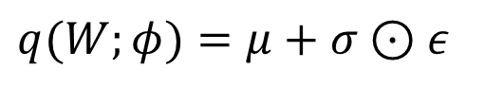
Graphical model
$$q\left(z | x;φ\right)$$
$$q(W;φ)$$
z
$$x$$
Inference network given x.
Globally updated
parameter w.r.t. all D= {(x,y)}.
$$W$$
$$μ$$
$$σ$$
$$x$$
$$y$$
$$N$$
$$N$$
$$q(W;φ)=μ+σ⊙ε$$
(if q is gaussian. )
VAE
Bayesian NN

Slide 24
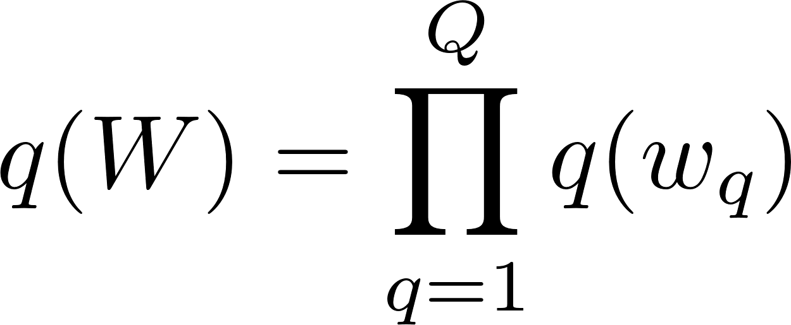











Dropout variational distribution
model.py

Slide 25










Deriving ELBO
$$x$$
$$W_{1}$$
$$W_{2}$$
$$y$$
$$N$$

Slide 26




Evaluating the KL term
See https://arxiv.org/pdf/1506.02157.pdf for the derivation.
model.py line 13

Slide 27





Evaluating the likelihood term
dropout masks

Slide 28








The role of weight decay
: weight decay parameter
(tunable with cross validation)
too small $λ$
(too weak prior)
good $λ$
too large $λ$
(too strong prior)

Slide 29



Training
./results/run/train.log

Slide 30


Testing
1. Naïve approximation
run.py
line 105
2. MC sampling
run.py
line 113

Slide 31

Uncertainty evaluation
Real test examples (MC sampling with S=1000)

Slide 32

Uncertainty evaluation
Synthetic test examples (S=1000)

Slide 33
Part III: Concrete-dropout

Slide 34



Idea
The optimal dropout probability $\overline{p}$ is found with grid-search. Can we learn $\overline{p}$ ?
For each neuron, we have
[Gal et al.] Concrete Dropout, NIPS2017

Slide 35











Concrete Relaxation
Reparameterization trick for Bernoulli variables.
ex) $\overline{p}=0.5$
$$1$$
$$\tilde{ε}$$
$$0$$
$$u$$
layer.py
[Gal et al.] Concrete Dropout, NIPS2017

Slide 36
Final objective
For mini-batch SGD.
run.py line 56
Thus, the effect of regularization terms is relative to the size of dataset.
[Gal et al.] Concrete Dropout, NIPS2017

Slide 37

Evaluate uncertainties
Synthetic test examples

Slide 38



Learned keep probabilities
Number of train instances = 1000
Layer 1
input
Layer 2

Slide 39



Learned keep probabilities
Number of train instances = 10000
Layer 1
input
Layer 2

Slide 40

Test accuracy
 | Naïve approx | MC sampling
Base | 89.37 $±$ 0.32 | -
MC dropout | 90.07 $±$ 0.44 | 90.17 $±$ 0.23
Concrete dropout | 90.23 $±$ 0.21 | 90.20 $±$ 0.32
Variational dropout | 88.77 $±$ 0.53 | 89.60 $±$ 0.56

